Slide 1
VANGUARD’S
A/B TESTING

Slide 2
The digital world is evolving, and so are Vanguard’s clients. Vanguard believed that a more intuitive and modern User Interface (UI), coupled with timely in-context prompts (cues, messages, hints, or instructions provided to users directly within the context of their current task or action), could make the online process smoother for clients. The critical question was: Would these changes encourage more clients to complete the process?
Project Brief Context

Slide 3
Both groups navigated through an identical process sequence: an initial page, three subsequent steps, and finally, a confirmation page signaling process completion.
Control Group (A): Clients interacted with Vanguard’s traditional online process.
Test Group (B): Clients experienced the new, spruced-up digital interface.
Start
Step 1
Step 2
Step 3
Confirm

Slide 4
Completion Rate: The proportion of users who reach the final ‘confirm’ step.
Time Spent on Each Step (TSES): The average duration users spend on each step.
Error Rates: If there’s a step where users go back to a previous step, it may indicate confusion or an error. You should consider moving from a later step to an earlier one as an error.
The goal is to see if the new design leads to a better user experience and higher process completion rates.

Slide 5
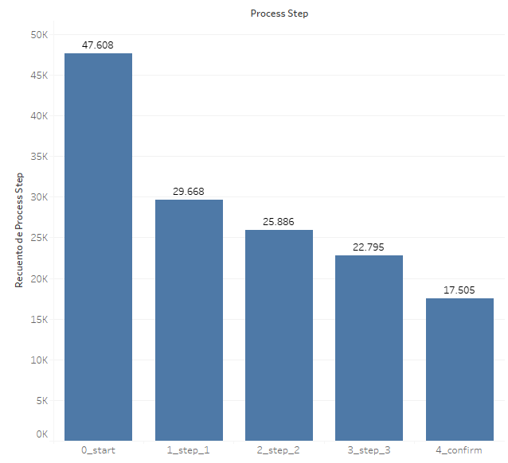
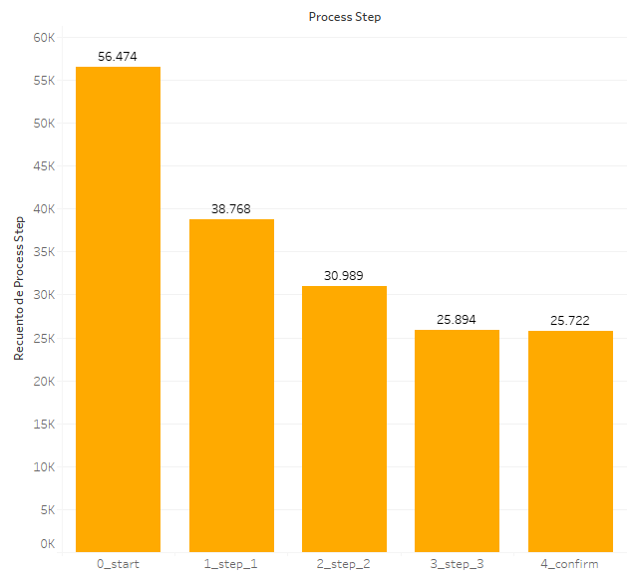
Sample size
23.532
Completion Rate
65.97%
Completion Rate
70.04%
Sample size
26.968
Control Group
Test Group
Error Rate
29.34%
Error Rate
34.13%
TSES:
TSES:
start step_1 step_2 step_3 confirm
84.00% 0.00% 0.00% 0.00% 15.00%
start step_1 step_2 step_3 confirm
71.67% 0.36% 0.03% 0.20% 27.75%

Slide 6
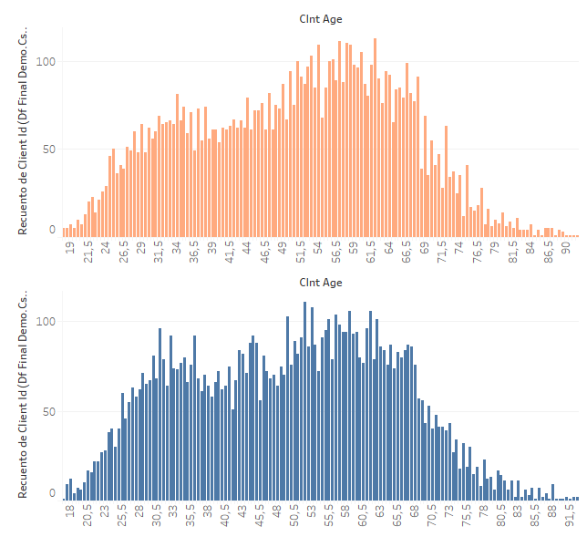
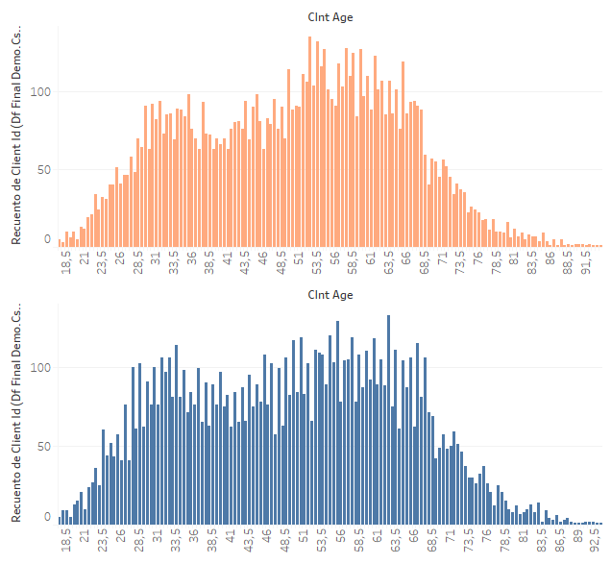
Sample size
23.532
Completion Rate
65.97%
Completion Rate
70.04%
Sample size
26.968
Control Group
Test Group
Error Rate
29.34%
Error Rate
34.13%
TSES:
TSES:
start step_1 step_2 step_3 confirm
84.00% 0.00% 0.00% 0.00% 15.00%
start step_1 step_2 step_3 confirm
71.67% 0.36% 0.03% 0.20% 27.75%

Slide 7
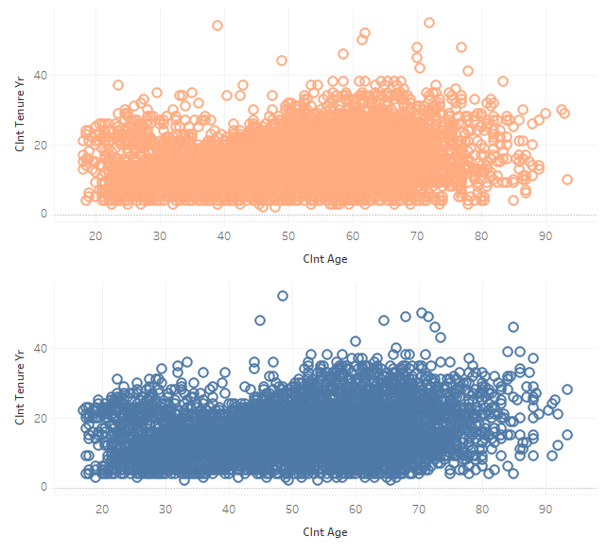
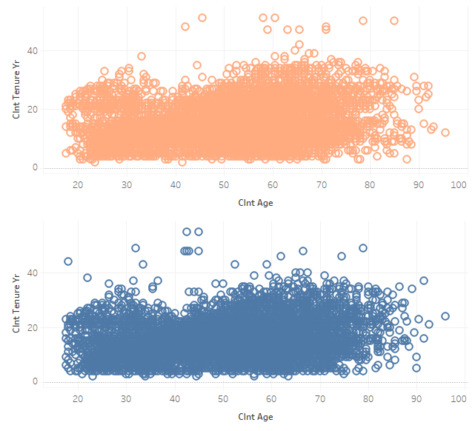
Sample size
23.532
Completion Rate
65.97%
Completion Rate
70.04%
Sample size
26.968
Control Group
Test Group
Error Rate
29.34%
Error Rate
34.13%
TSES:
TSES:
start step_1 step_2 step_3 confirm
84.00% 0.00% 0.00% 0.00% 15.00%
start step_1 step_2 step_3 confirm
71.67% 0.36% 0.03% 0.20% 27.75%

